Slide 1

Desired State Configuration 101 Workshop (v5)
Notes:
Use PowerShell v5. Believe me; just use v5 or another configuration management tool!

Slide 2
Iain Brighton
Principal Consultant @ Virtual Engine
Automation and End-user computing focused
RES Consulting Partner
RES Certified Trainer (RCT) and Valued Professional (RSVP)
Part-time Amateur Developer
PowerShell Junkie

Slide 3
What is DSC?
“A configuration management platform built into Windows that is based on open standards.”
Notes:
Windows PowerShell Desired State Configuration (DSC) is a configuration management platform built into Windows that is based on open standards. DSC is flexible enough to function reliably and consistently in each stage of the deployment lifecycle (development, test, pre-production, production), as well as during scale-out.
DSC centers around "configurations". A configuration is an easy-to-read document that describes an environment made up of computers ("nodes") with specific characteristics. These characteristics can be as simple as ensuring a specific Windows feature is enabled or as complex as deploying SharePoint.
DSC also has monitoring and reporting built in. If a system is no longer compliant, DSC can raise an alert and act to correct the system.

Slide 4
Why Configuration Management
Revision/version control
Configuration identification
Change management
Release management
Accounting and auditing
Notes:
Configuration Management focuses on establishing, and maintaining, the consistency of a system or product throughout its lifetime.
Declarative documents - No implementation details

Slide 5
Components
Configurations
PowerShell-authored
Documents
DMTF standard
Do not have to generated by PowerShell
Local Configuration Manager (LCM)
Resources
Notes:
Configurations can have comment-based help ☺

Slide 6
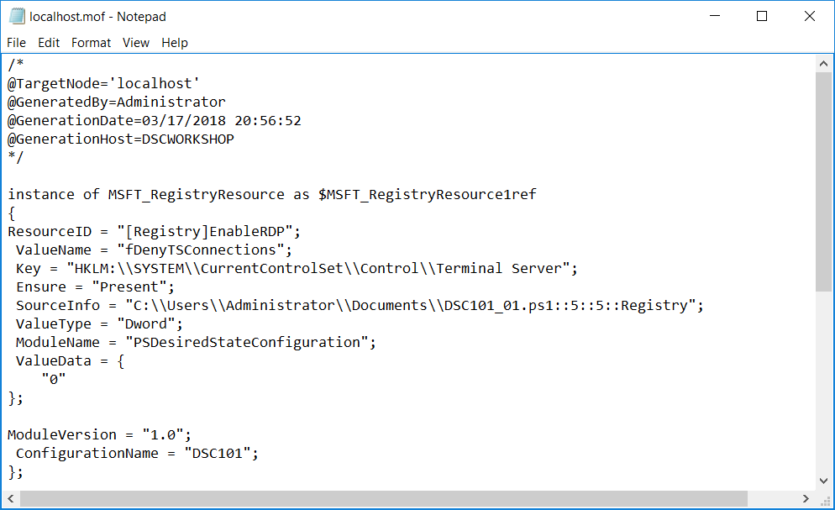

Slide 7
Resources
Types
Binary
Script
Class-based
Idempotent
Manual invocation via Invoke-DscResource
Implement 3 functions/methods
Get-TargetResource
Test-TargetResource
Set-TargetResource
Notes:
To generate mof documents with PowerShell, the DSC resources must reside on the host generating the configuration

Slide 8
Push and Pull (and Tug)
Default installation configured for push mode
Pull servers enable central configuration
LCM (node) is registered with the pull server
Assigned one or more configurations
Resources can be automatically downloaded
Available options:
Azure Automation DSC
Windows Server DSC pull service
An SMB share
Tug
Resources are zipped, with checksums
Notes:
A Windows Server DSC pull service can be deployed using the xDSCWebService resource!
Checksums are created using the New-DscChecksum cmdlet

Slide 9
Create Simple Configuration
Enable ICMP Echo through firewall using xFirewall resource
Name 'FPS-ICMP4-ERQ-In', inbound on any network profile
Name 'FPS-ICMP6-ERQ-In', inbound on any network profile
Disable Server Manager using Registry resource
HKLM:\Software\Microsoft\ServerManager\DoNotOpenServerManagerAtLogon
Dword: 1
Enable PS Transcription using cAdministrativeTemplateSetting
HKLM:\Software\Policies\Microsoft\Windows\PowerShell\Transcription\EnableTranscripting
Dword: 1

Slide 10
Handling Credentials
Credential vs PSDSCRunAsCredential
PSDSCRunAsCredential added in v5
AllowPlainTextPassword is for lab environments only!
Certificates
Encryption certificates must contain the Data Encipherment or Key Encipherment key usage, and
Include the Document Encryption Enhanced Key Usage
Added requirement in v5
Notes:
Credential needs to be implemented by the resource.
PSDSCRunAsCredential (added in v5) executes the resource under the specified credential

Slide 11
Composite Resources
Are reusable configurations
Import the composite configuration just like a DSC resource
Look just like configurations
Contain the Configuration keyword
Saved with the .schema.psm1 file extension
Notes:
Declarative document -

Slide 12
Partial Configurations
Allows configurations to be delivered in fragments and from multiple sources
The Local Configuration Manager (LCM) on the target node puts the fragments together before applying them as a single configuration
This capability allows sharing control of configuration between teams or individuals
Publish-DscConfiguration used when pushing partial configurations
Notes:
https://docs.microsoft.com/en-us/powershell/dsc/partialconfigs

Slide 13
Create Parameterised Configuration
Create an $ICMP parameter to control whether the firewall rule is enabled
You could use either a [String] or [Boolean] parameter type
[Boolean] will probably require a .ToString() extension method to be used
Create a $DisableServerManager to control whether Server Manager is started or not
You will have fun if you use a [Switch] parameter!

Slide 14
Configuration Data
Separation of environmental data
Defined in a hashtable, saved with a .psd1 extension
Passed to a configuration when compiled
Notes:
https://docs.microsoft.com/en-us/powershell/dsc/separatingenvdata

Slide 15
PowerShell Core
New LCM written in C++
To be made open-source
New provider model
First provider being Windows PowerShell
No changes to resources required*
PowerShell Core, C++ and Python planned
Notes:
* Famous last words!
https://blogs.msdn.microsoft.com/powershell/2018/01/26/dsc-planning-update-january-2018/

Slide 16
Lability
Notes:
Declarative document -

Slide 17
Questions?

Slide 18
Links
https://docs.microsoft.com/en-us/powershell/dsc/index
https://blogs.infosupport.com/safely-using-pscredentials-in-a-powershell-dsc-configuration/
https://docs.microsoft.com/en-us/powershell/dsc/bootstrapdsc
https://docs.microsoft.com/en-us/powershell/dsc/resourceauthoringchecklist
Notes:
Declarative document -

Slide 19
Thanks for listening!
iain.brighton@virtualengine.co.uk
@iainbrighton

Slide 20
Why Not Use DSC?
Infrastructure as code
Requires orchestration
AWS CloudFormation
Azure Resource Templates
Chef and Puppet etc.
Notes:
Declarative document -

Slide 21
DSC 1.0 Updates
KB 2883200
%ProgramFiles%\WindowsPowershell\Modules
KB 3000850
Start-DSCConfiguration –UseExisting
Stop-DSCConfiguration
Remove-DSCConfigurationDocument
Update-DSCConfiguration

Slide 22
DSC 2.0 Enhancements
Scheduled Tasks Removed
Class-based Resources
Push and Pull Partial Configurations
PsDscRunAsCredential

